Slide 1
AVR Microcontroller
Microprocessor Course
Chapter 15
INPUT CAPTURE AND WAVE
GENERATION IN AVR
Bahman 1397 (Version 1.2)

Slide 2
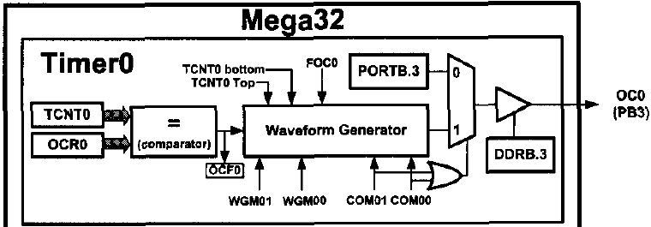
INPUT CAPTURE AND WAVE GENERATION IN AVR SECTION 15.1: WAVE GENERATION USING 8-BIT TIMERS
For each timer there is, at least, an OCRn register (like OCR0 for Timer0). As shown in Figures 15-1 and 15-2, in each AVR timer there is a waveform generator.
The waveform generator can generate waves on the OCn pin. The WGMn and COMn bits of the TCCR register determine how the waveform generator works.

Slide 3
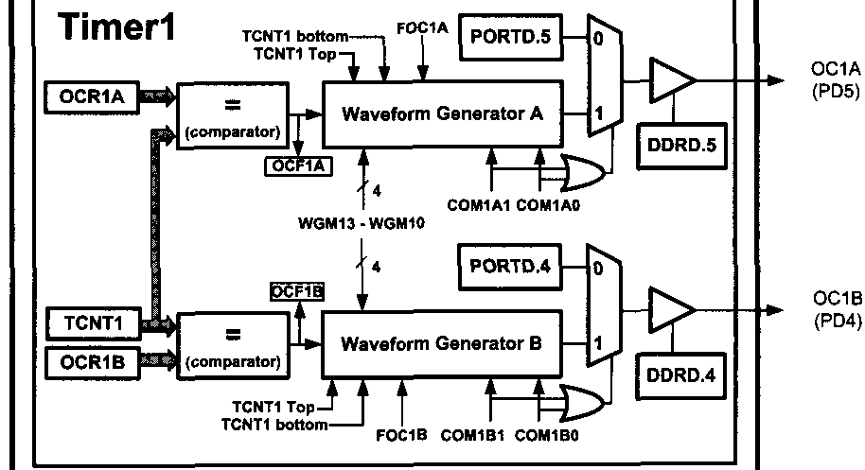
INPUT CAPTURE AND WAVE GENERATION IN AVR SECTION 15.1: WAVE GENERATION USING 8-BIT TIMERS

Slide 4
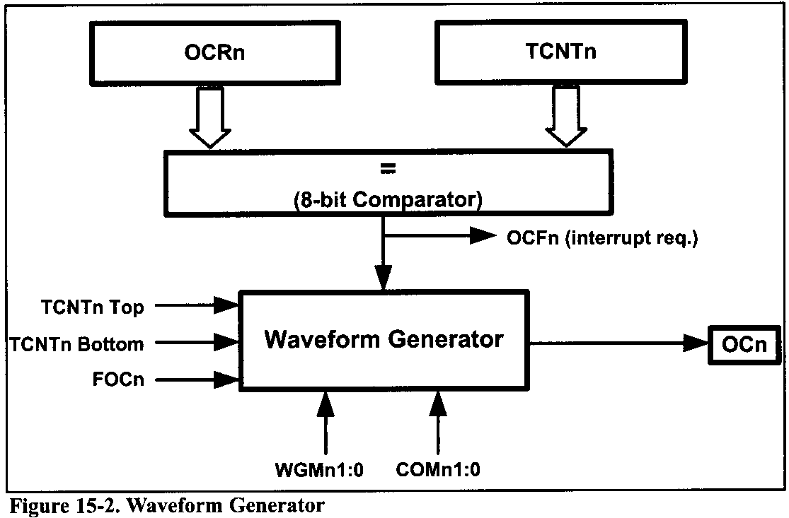
INPUT CAPTURE AND WAVE GENERATION IN AVR SECTION 15.1: WAVE GENERATION USING 8-BIT TIMERS
When the TCNTn register reaches Top or Bottom or compare match occurs, the waveform generator is informed. Then the waveform generator changes the state of the OC0 pin according to the mode of the timer (WGM01:00 bits of the TCCR0 register) and the COM01 (Compare Output Mode) and COM00 bits. See Figure 15-4.

Slide 5
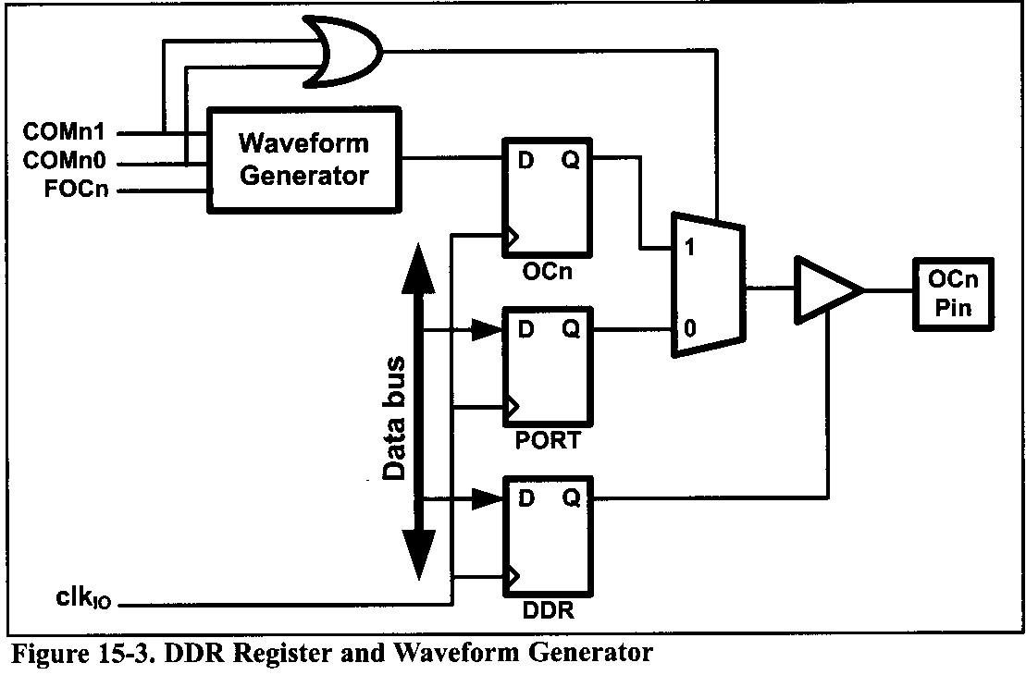
INPUT CAPTURE AND WAVE GENERATION IN AVR SECTION 15.1: WAVE GENERATION USING 8-BIT TIMERS
In ATmega32/ATmegal6, OC0 is the alternative function of PB3. In other words, the PB3 functions as an I/O port when both COM01 and COM00 are zero. Otherwise, the pin acts as a wave generator pin controlled by a waveform generator.
We should set the OC0 pin as an output pin when we want to use it for generating waves.

Slide 6
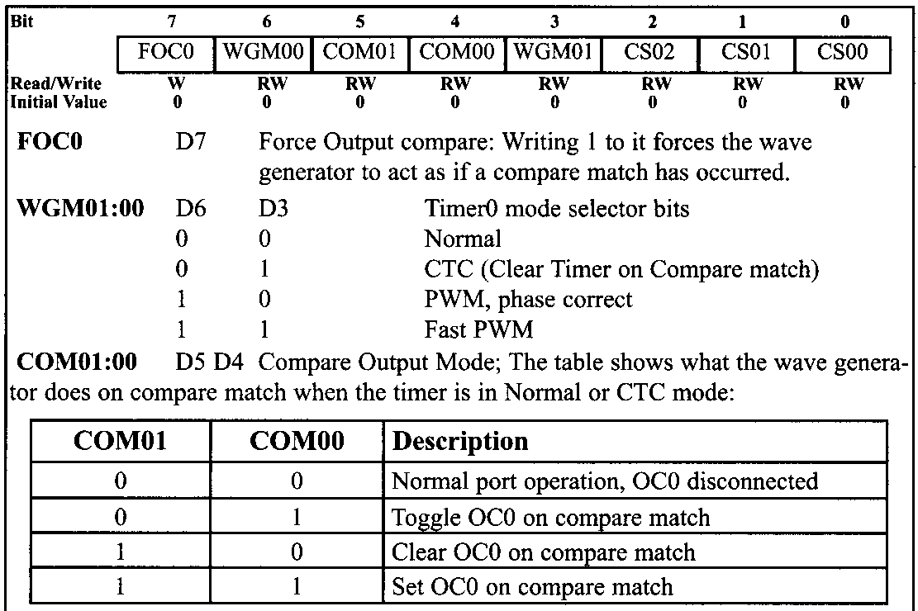
INPUT CAPTURE AND WAVE GENERATION IN AVR SECTION 15.1: WAVE GENERATION USING 8-BIT TIMERS

Slide 7
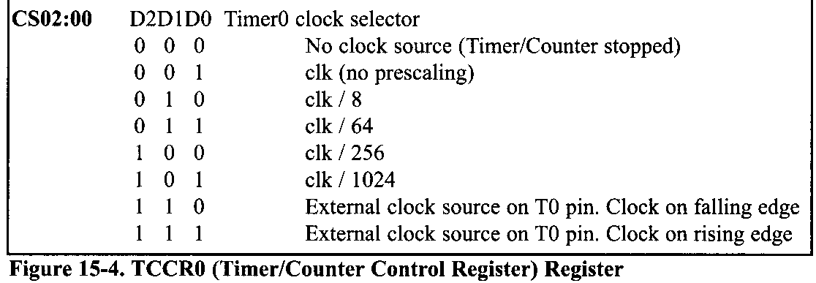
INPUT CAPTURE AND WAVE GENERATION IN AVR SECTION 15.1: WAVE GENERATION USING 8-BIT TIMERS

Slide 8
INPUT CAPTURE AND WAVE GENERATION IN AVR SECTION 15.1: WAVE GENERATION USING 8-BIT TIMERS
Wave generation Normal and CTC modes
When Timer0 is in CTC (WGM01:0 = 10) or Normal (WGM01:0 = 00) mode after a compare match occurs, the OC0 pin can perform one of the following actions, depending on the value of the COM01:0 bits:
(a) Remain unaffected
(b) Toggle the OC0 pin
(c) Clear (Drive low) the OC0 pin
(d) Set (Drive high) the OC0 pin
We use the COM01 and COM00 bits to select one of the above actions

Slide 9
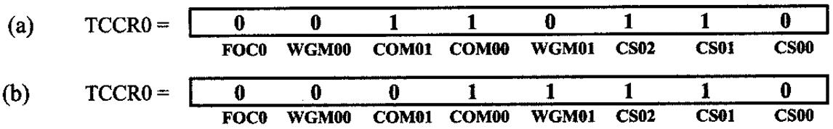
INPUT CAPTURE AND WAVE GENERATION IN AVR SECTION 15.1: WAVE GENERATION USING 8-BIT TIMERS
Example 15-1
Using Figure 15-4, find the TCCR0 register value to:
Set high the OC0 pin upon match. Use external clock, falling edge, and Normal mode.
Toggle the OC0 pin upon match. Use external clock, falling edge, and CTC mode.
Solution:

Slide 10
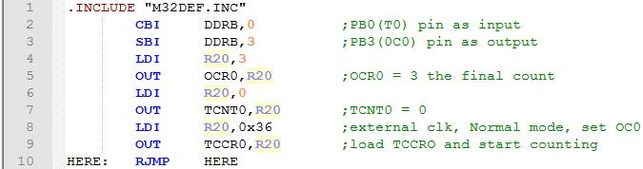
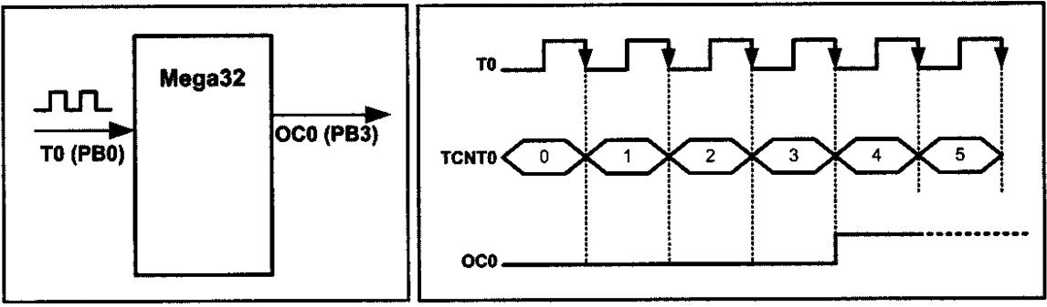
INPUT CAPTURE AND WAVE GENERATION IN AVR SECTION 15.1: WAVE GENERATION USING 8-BIT TIMERS
Example 15-2
Write a program that
after 4 external clocks turns on an LED connected to the OC0 pin,
toggles the OC0 pin every 4 pulses.
Solution: (a)

Slide 11
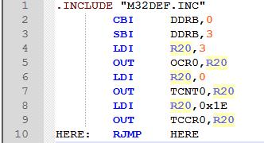
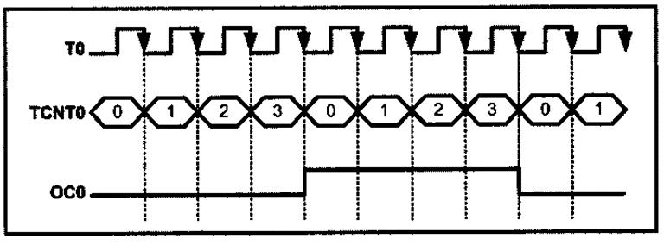
INPUT CAPTURE AND WAVE GENERATION IN AVR SECTION 15.1: WAVE GENERATION USING 8-BIT TIMERS
(b)
Notice that there is no need to monitor the OCF0 flag, which means the AVR can do other tasks.

Slide 12
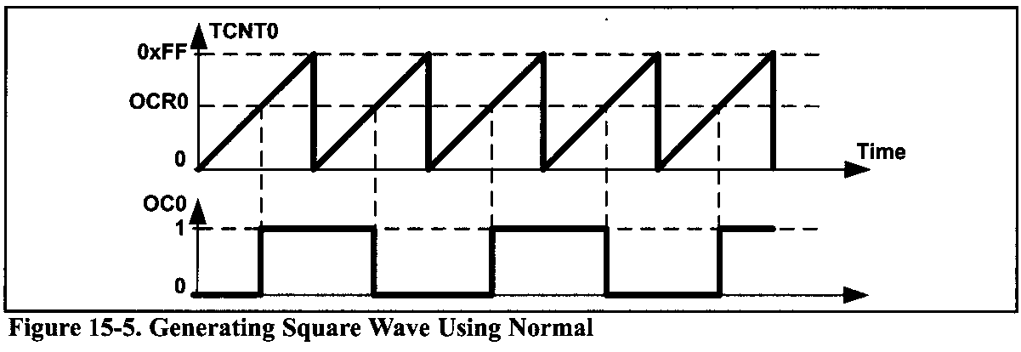
INPUT CAPTURE AND WAVE GENERATION IN AVR SECTION 15.1: WAVE GENERATION USING 8-BIT TIMERS
Generating square waves
To generate square waves we can set the timer to Normal mode or CTC mode and set the COM bits to the toggle mode (COM01:00 = 01). The OC0 pin will be toggled on each compare match and a square wave will be generated.

Slide 13
INPUT CAPTURE AND WAVE GENERATION IN AVR SECTION 15.1: WAVE GENERATION USING 8-BIT TIMERS
Example 15-3
Find the value for TCCR0 if we want to program Timer0 as a Normal mode square wave generator and no prescaler.
Solution:

Slide 14
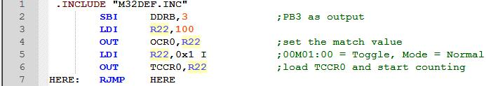
INPUT CAPTURE AND WAVE GENERATION IN AVR SECTION 15.1: WAVE GENERATION USING 8-BIT TIMERS
Example 15-4
Assuming XTAL = 8 MHz, calculate the frequency of the wave generated by the following program:
Solution:
There are 256 clocks between two consecutive matches. Therefore
T_{timer clock} = 1/8 MHz = 0.125 µs
T_{wave} = 2 × 256 × 0.125 µs = 64 µs
F_{wave} =1/64 µs = 15,625 Hz = 15.625 kHz Note: In Normal mode, when match occurs, the OC0 pin toggles and the timer continues to count up until it reaches the top value.

Slide 15
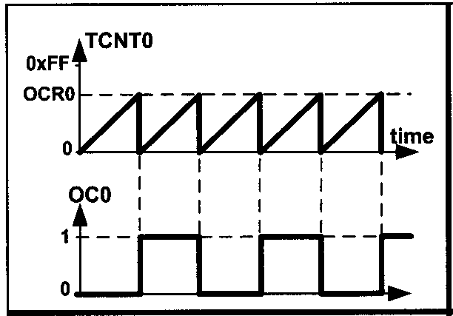
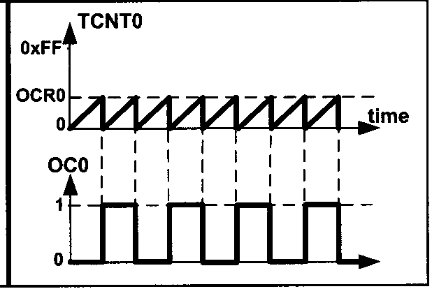
INPUT CAPTURE AND WAVE GENERATION IN AVR SECTION 15.1: WAVE GENERATION USING 8-BIT TIMERS
Generating square waves using CTC
The CTC mode is better than Normal mode for generating square waves, since the frequency of the wave can be easily adjusted using the OCR0 register.

Slide 16
INPUT CAPTURE AND WAVE GENERATION IN AVR SECTION 15.1: WAVE GENERATION USING 8-BIT TIMERS
Example 15-5
Find the value for TCCR0 if we want to program Timer0 as a CTC mode square wave generator and no prescaler.
Solution:
WGM01:00 = 10 = CTC mode
COM01:00 = 01 = Toggle
CS02:00 = 001 = No prescaler
FOC0 = 0

Slide 17
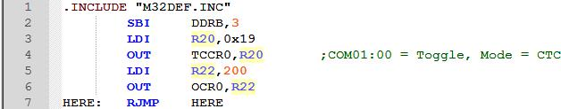
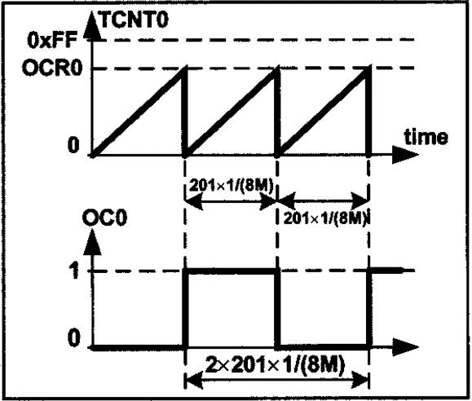
INPUT CAPTURE AND WAVE GENERATION IN AVR SECTION 15.1: WAVE GENERATION USING 8-BIT TIMERS
Example 15-6
Assuming XTAL = 8 MHz, calculate the frequency of the wave generated by the following program:
Solution:
Between two consecutive matches it takes 200+1=201 clocks and
T_{timer clock} =1/8MHz=0.125 µs
T_{wave} = 2×201×0.125 µs=50.25 µs
F_{wave}=1/50.25 µs=19,900 Hz=19.900 kHz

Slide 18
INPUT CAPTURE AND WAVE GENERATION IN AVR SECTION 15.1: WAVE GENERATION USING 8-BIT TIMERS
Example 15-7
In Example 15-6, calculate the frequency of the wave generated in each of the following cases:
OCR0 is loaded with 50
XTAL = 4 MHz and OCR0 is loaded with 95
prescaler is 8, XTAL = 1 MHz, OCR0 = 150
prescaler is N, XTAL = Fosc, OCR0 = X
Solution:
(a) 50 + 1 = 51 clocks and t_{timer clock}=0.125 µs ⇒T_{wave}= 2×51×0.125µs=12.75µs
⇒ F_{wave}=1/50.25µs=19,900 Hz=19.900 kHz
(b) 95+1=96 clocks and T_{timer clock}=1/4 MHz=0.25µs ⇒ T_{wave}=2×96×0.25µs=48µs
⇒ F_{wave}=1/48µs=20,833 Hz = 20.833 kHz
(c) 150+1=151 clocks and T_{timer clock}=8×1/1MHz=8µs ⇒ T_{wave}=2×151×8µs=2416µs
⇒ F_{wave}=1/2416µs=413.9 Hz
(d) X+1clocks and T_{timer clock}=N×1/F_{osc}=N/Fosc ⇒ T_{wave}=2×(X+1)×N/Fosc
⇒ F_{wave} = 1 / T_{wave} = F_{osc} / [2N(X + 1)]

Slide 19
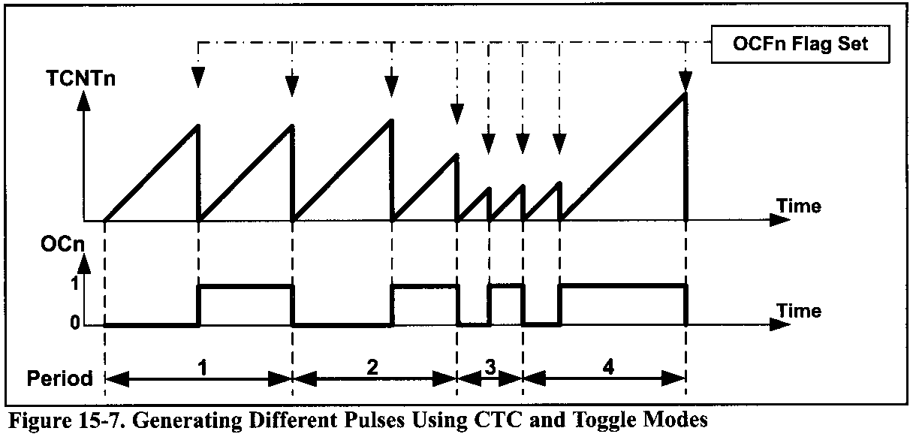
INPUT CAPTURE AND WAVE GENERATION IN AVR SECTION 15.1: WAVE GENERATION USING 8-BIT TIMERS
Generating pulses using CTC mode
When a timer is in the CTC mode and COM is in the toggle mode, the value of the OCRn represents how many clocks it counts before it toggles the pin. This way, we can generate different pulses by loading different values into the OCRn register.

Slide 20
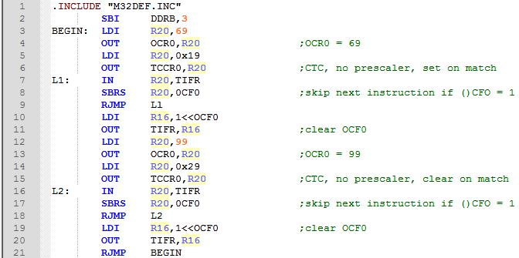
INPUT CAPTURE AND WAVE GENERATION IN AVR SECTION 15.1: WAVE GENERATION USING 8-BIT TIMERS
Example 15-8
Assuming XTAL = 1 MHz, draw the wave generated by the following program:

Slide 21
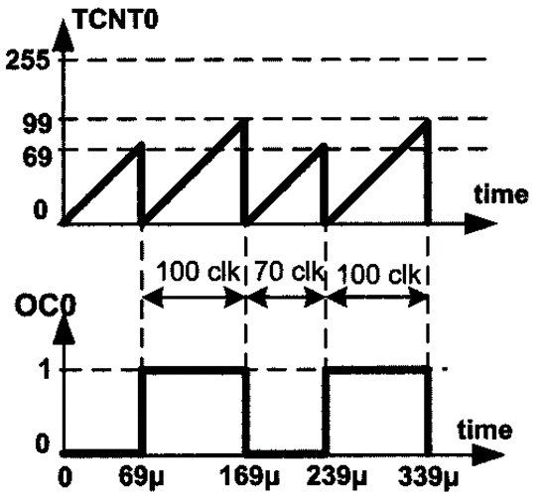
INPUT CAPTURE AND WAVE GENERATION IN AVR SECTION 15.1: WAVE GENERATION USING 8-BIT TIMERS
Solution:
T_{timer clock} = 1 / 1 MHz = 1 µs
T₀= 70 x 1 µs = 70 µs
T₁ = 100 x 1 µs = 100 µs
T_{wave}= 70 µs + 100 µs = 170 µs
F_{wave} = 1 / 170 µs = 5882 Hz

Slide 22
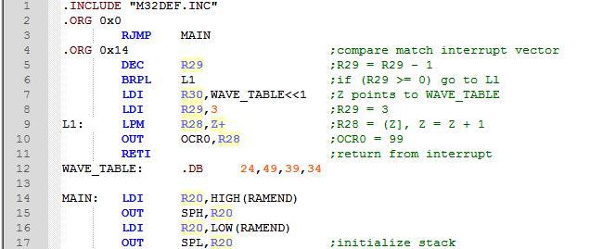
INPUT CAPTURE AND WAVE GENERATION IN AVR SECTION 15.1: WAVE GENERATION USING 8-BIT TIMERS
To load values to the OCRn we can use the compare match interrupt as well. Upon a compare match, the pin will be toggled and an interrupt will be invoked.
Example 15-9
Assuming XTAL = 1 MHz, draw the wave generated by the following program:

Slide 23
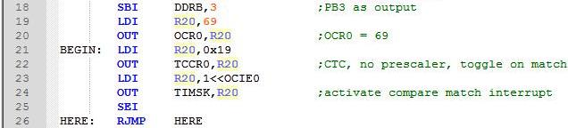
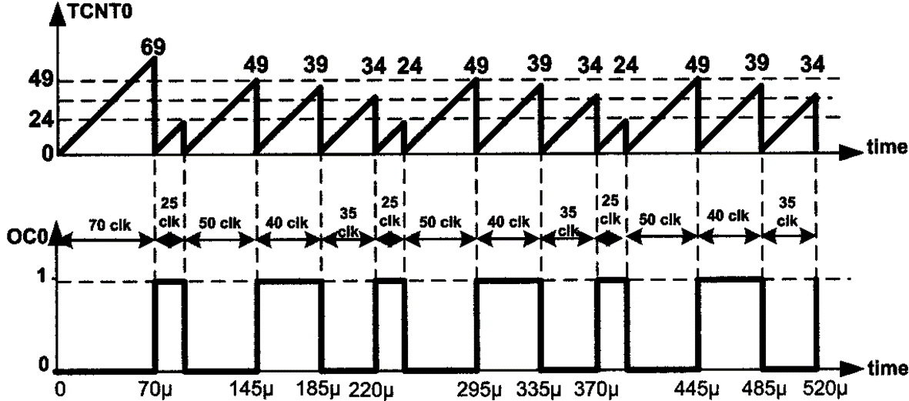
INPUT CAPTURE AND WAVE GENERATION IN AVR SECTION 15.1: WAVE GENERATION USING 8-BIT TIMERS
Solution:

Slide 24
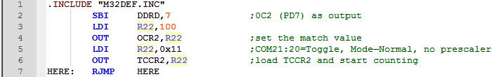
INPUT CAPTURE AND WAVE GENERATION IN AVR SECTION 15.1: WAVE GENERATION USING 8-BIT TIMERS
Generating waves using Timer2
We can generate waves using Timer2 or any other 8-bit timer the same way as we did using Timed. We should simply use the proper registers and monitor the associated flag.
Example 15-11
Rewrite the program of Example 15-4 using Timer2.
Solution:

Slide 25
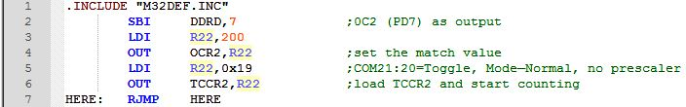
INPUT CAPTURE AND WAVE GENERATION IN AVR SECTION 15.1: WAVE GENERATION USING 8-BIT TIMERS
Example 15-12
Rewrite the program of Example 15-6 using Timer2.
Solution:

Slide 26
INPUT CAPTURE AND WAVE GENERATION IN AVR SECTION 15.2: WAVE GENERATION USING TIMER1
The different modes of Timer1
The WGM13, WGM12, WGM11, and WGM10 bits define the mode of Timer1. Timer1 has 16 different modes. These modes can be categorized into five groups:
Normal,
CTC,
Fast PWM,
Phase Correct PWM, and
Phase and Frequency Correct PWM
We learned about the operation of the first two categories in Chapter 9; the operation of the other categories will be discussed in this part.
Before discussing the operation of the different modes we should define the meaning of Top.

Slide 27
INPUT CAPTURE AND WAVE GENERATION IN AVR SECTION 15.2: WAVE GENERATION USING TIMER1
Top in Timer1
Top is the highest value that the TCNT register reaches while counting. In 8-bit timers (e.g., Timer0) the top value is 0xFF except for the CTC mode, whose top can be defined by OCRn. In 16-bit timers such as Timer1 the top values are as follows:
In Normal mode (mode 0) the top value is 0xFFFF.
In some modes the top value is fixed and is other than the maximum; the top value can be 0xFF, 0x1FF, or 0x3FF.
In some other modes the top can be defined by either the OCR1A register or the ICR1 register.

Slide 28
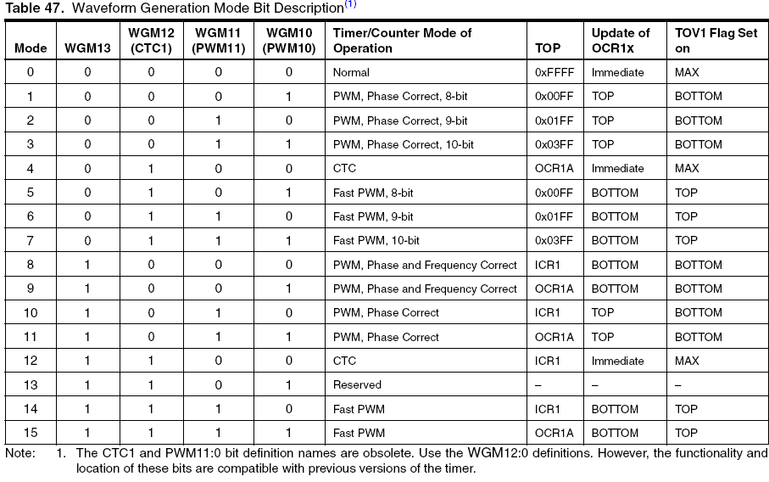
INPUT CAPTURE AND WAVE GENERATION IN AVR SECTION 15.2: WAVE GENERATION USING TIMER1

Slide 29
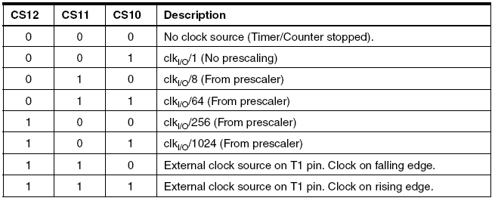
INPUT CAPTURE AND WAVE GENERATION IN AVR SECTION 15.2: WAVE GENERATION USING TIMER1

Slide 30
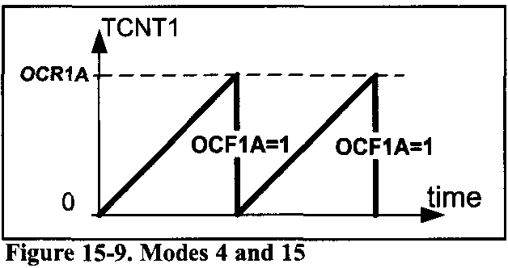
INPUT CAPTURE AND WAVE GENERATION IN AVR SECTION 15.2: WAVE GENERATION USING TIMER1
CTC mode
As shown in Figure 15-8, modes 4 and 12 operate in the CTC mode. They are almost the same. The only difference between them is that in mode 4, the top value is defined by OCR1A, whereas in mode 12, ICR1 specifies the top.
As mentioned in Chapter 9, in mode 4, the timer counts up until it reaches OCR1A; then the timer will be cleared and the OCF1A flag will be set as a result of compare match.
Figure 15-9. Modes 4 and 12

Slide 31
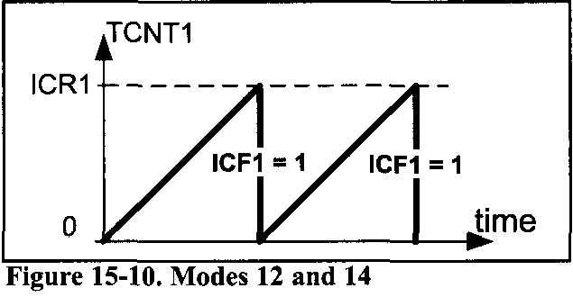
INPUT CAPTURE AND WAVE GENERATION IN AVR SECTION 15.2: WAVE GENERATION USING TIMER1
CTC mode
In mode 12, the timer counts up until it reaches ICR; then the timer will be cleared and the ICF1 flag will be set. So, in mode 12, the timer works almost the same way as mode 4. See Example 15-13 and compare it with Example 9-22.

Slide 32
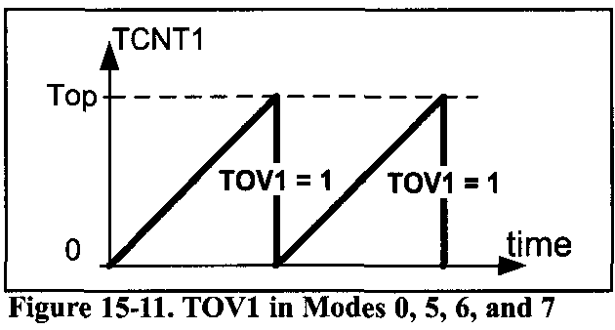
INPUT CAPTURE AND WAVE GENERATION IN AVR SECTION 15.2: WAVE GENERATION USING TIMER1
In other words, in Normal, CTC, and Fast PWM, the timer counts up until it reaches the top and then rolls over to zero. But the top value is different in the different modes and as a result, different flags are set when the timer rolls over.
when the top value is a fixed value, the TOV1 flag is set;
when the OCR1A register defines the top, the OCF1 flag will be set; and
when the top is defined by the ICR1 register, the ICF1 flag will be set.

Slide 33
INPUT CAPTURE AND WAVE GENERATION IN AVR SECTION 15.2: WAVE GENERATION USING TIMER1
See You might find the contents of these two pages confusing. There is no need to memorize the details. All you need to know is how the timer counts in each of the five categories of operations (Normal, CTC, etc.) and how to use the information mentioned in Figure 15-8. The following is a summary:
Counting:
In Normal, CTC, and Fast PWM modes the timer counts up until it reaches the top value. Then the timer rolls over to zero and a flag is set:
If the top is a fixed value, TOV1 will be set.
If the OCR1A register represents the top, the OCF1A will be set.
If the ICR1 register defines the top, the ICF1 will be set.

Slide 34
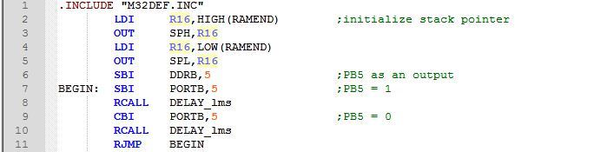
INPUT CAPTURE AND WAVE GENERATION IN AVR SECTION 15.2: WAVE GENERATION USING TIMER1
Example 15-13
Rewrite Example9-27 using the ICR1 flag.
Solution:
To wait 10,000 clocks we should load the ICR1 flag with 10,000- 1 = 9999 = 0x270F and use mode 14.

Slide 35
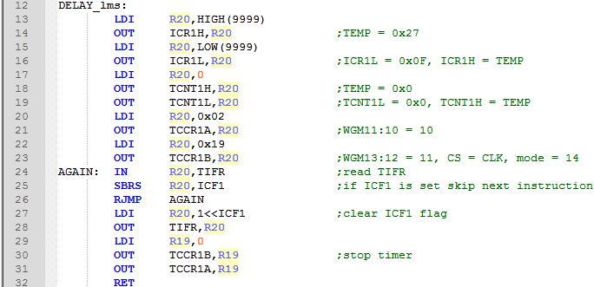
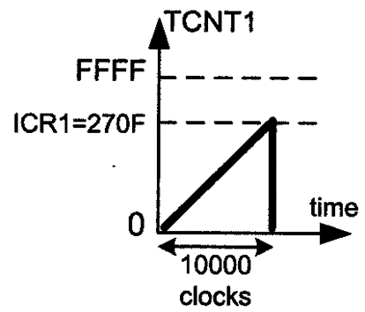
INPUT CAPTURE AND WAVE GENERATION IN AVR SECTION 15.2: WAVE GENERATION USING TIMER1

Slide 36
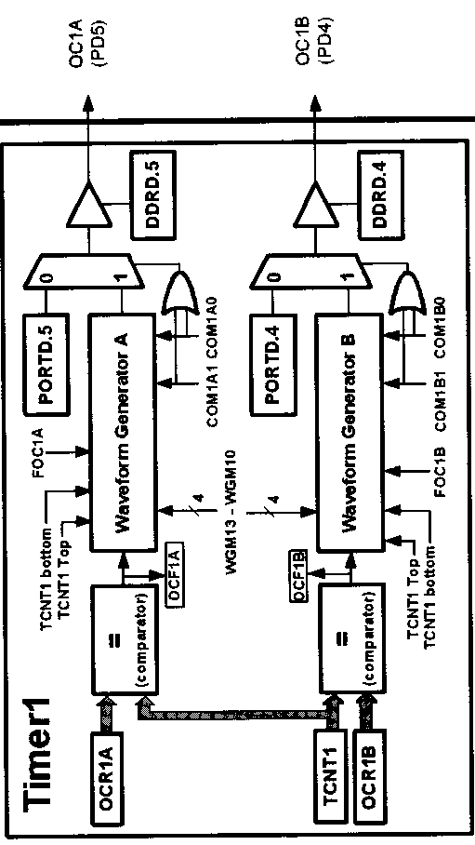
INPUT CAPTURE AND WAVE GENERATION IN AVR SECTION 15.2: WAVE GENERATION USING TIMER1
Waveform generators in Timer1
In examining Figures 15-12 and 15-13 we see that Timer1 has two independent waveform generators: Waveform Generator A and Waveform Generator B.
The compare match between OCR1A and TCNT1 affects Waveform Generator A, and the wave generated by Waveform Generator A shows up on the OC1A pin.
The compare match between OCR1B and TCNT1 affects Waveform Generator B, and the wave generated by Waveform Generator B shows up on the OC1B pin.

Slide 37
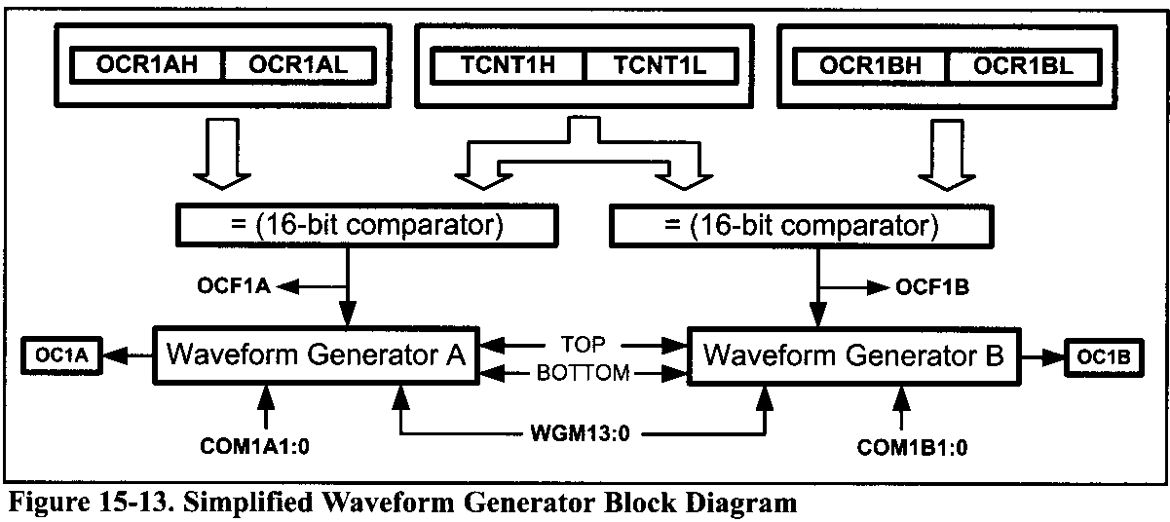
INPUT CAPTURE AND WAVE GENERATION IN AVR SECTION 15.2: WAVE GENERATION USING TIMER1
The COM1A1 and COM1A0 bits have control over Waveform Generator A; whereas COM1B1 and COM1B0 control Waveform Generator B. All of the COM bits are in the TCCR1A register.
The operation mode of Timer1 (WGM13, WGM12, WGM11, and WGM10 bits of TCCR1A and TCCR1B) affect both generators.

Slide 38
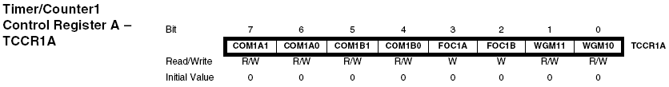
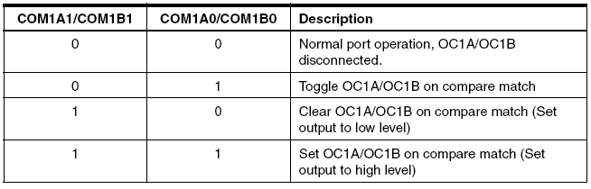
INPUT CAPTURE AND WAVE GENERATION IN AVR SECTION 15.2: WAVE GENERATION USING TIMER1
Waveform generators in Timer1
In examining Figures 15-12 and 15-13 we see that Timer1 has two independent waveform generators: Waveform Generator A and Waveform Generator B.

Slide 39
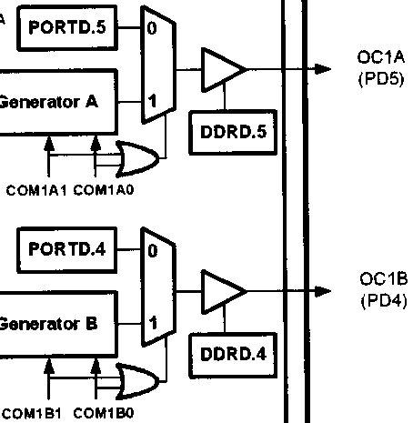
INPUT CAPTURE AND WAVE GENERATION IN AVR SECTION 15.2: WAVE GENERATION USING TIMER1
In ATmega32, OC1A and OC1B are the alternative functions of PD5 and PD4, respectively.
The PD5 pin functions as an I/O port when both COM1A1 and COM1A0 are zero. Otherwise, the pin acts as a wave generator pin controlled by Waveform Generator A.
The PD4 functions as an I/O port when both COM1B1 and COM1B0 are zero. Otherwise, the pin acts as a wave generator pin controlled by Waveform Generator B.

Slide 40
INPUT CAPTURE AND WAVE GENERATION IN AVR SECTION 15.2: WAVE GENERATION USING TIMER1
Wave generation in Normal and CTC modes
When Timer1 is in CTC (WGM13:0 = 0100 or WGM13:0 = 1100) or Normal (WGM13:0 = 0000) mode after a compare match occurs, the waveform generators can perform one of the following actions, depending on the values of COM1A1:0 and COM1B1:0 bits, respectively:
Remain unaffected
Toggle the OC1x pin (OC1A or OC1B)
Clear (drive low) the OC1x pin
Set (drive high) the OC1x pin
The COM1A1 and COM1A0 bits select the operation of OC1A, while COM1B1 and COM1B0 select the operation of OC1B.

Slide 41
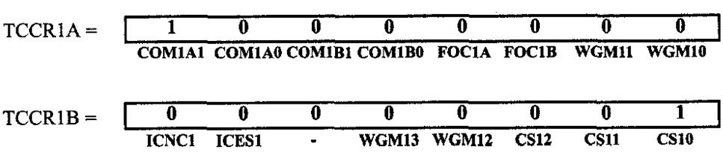
INPUT CAPTURE AND WAVE GENERATION IN AVR SECTION 15.2: WAVE GENERATION USING TIMER1
Example 15-14
Using Figures 15-8 and 15-14, find the values of the TCCR1A and TCCR1B registers if we want to clear the OC1A pin upon match, with no prescaler, internal clock, and Normal mode.
Solution:
WGM13:10 = 0000 = Normal mode
COM1A 1 :0 = 10 = Clear
CS 12:10 = 001 = No prescaler

Slide 42
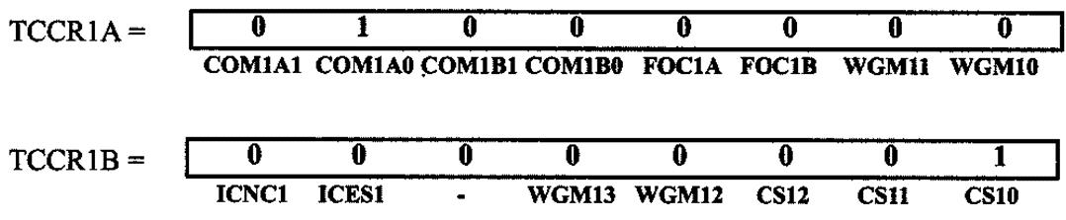
INPUT CAPTURE AND WAVE GENERATION IN AVR SECTION 15.2: WAVE GENERATION USING TIMER1
Waveform generators in Timer1
In examining Figures 15-12 and 15-13 we see that Timer1 has two independent waveform generators: Waveform Generator A and Waveform Generator B.
Example 15-15
Find the value for TCCR1A and TCCR1B to program Timerl as Normal mode and the OC 1 A generator as square wave generator and no prescaler.
Solution:
WGM13:10 = 0000 = Normal mode
COM1A1:0 = 01 = Toggle
CS12 :10 = 001 = No prescaler
FOC1A = 1
FOC1B = 1

Slide 43
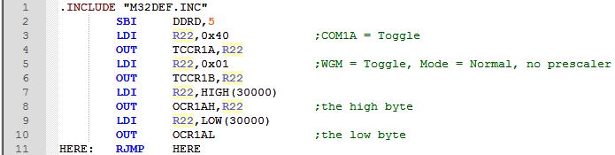
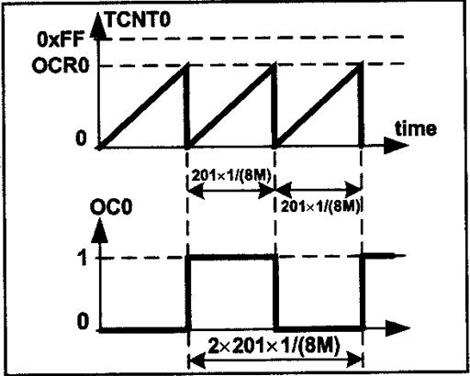
INPUT CAPTURE AND WAVE GENERATION IN AVR SECTION 15.2: WAVE GENERATION USING TIMER1
Example 15-16
Assuming XTAL = 8 MHz, calculate the frequency of the wave generated by the following program:
Solution:
From one compare match to the next one
it takes 65,536 clocks and
T_{timer clock} = 1/8 MHz = 0.125 µs
T_{wave} = 2 × 65,536 × 0.125 µs = 16,384 µs
F_{wave} = 1/16,384 µs = 61.035 Hz

Slide 44
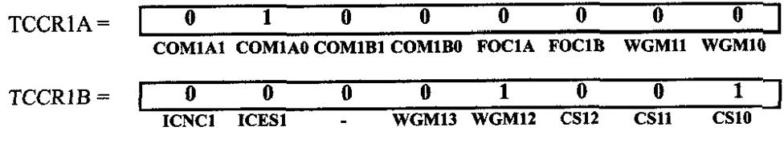
INPUT CAPTURE AND WAVE GENERATION IN AVR SECTION 15.2: WAVE GENERATION USING TIMER1
CTC mode is better than Normal mode for generating square waves, as the frequency of the wave can be easily adjusted by changing the top value In CTC mode, when OCR1x has a lower value, compare match occurs earlier and the period of the generated wave is smaller (higher frequency).
Example 15-17
Find the value for TCCR1A and TCCR1B to program Timer1 as CTC mode and the OC1A generator as square wave generator and no prescaler.
Solution:
WGM13:10 = 0100 = CTC
COM1A1:0 = 01 = toggle
CS 12:10 = 001 = no prescaler

Slide 45
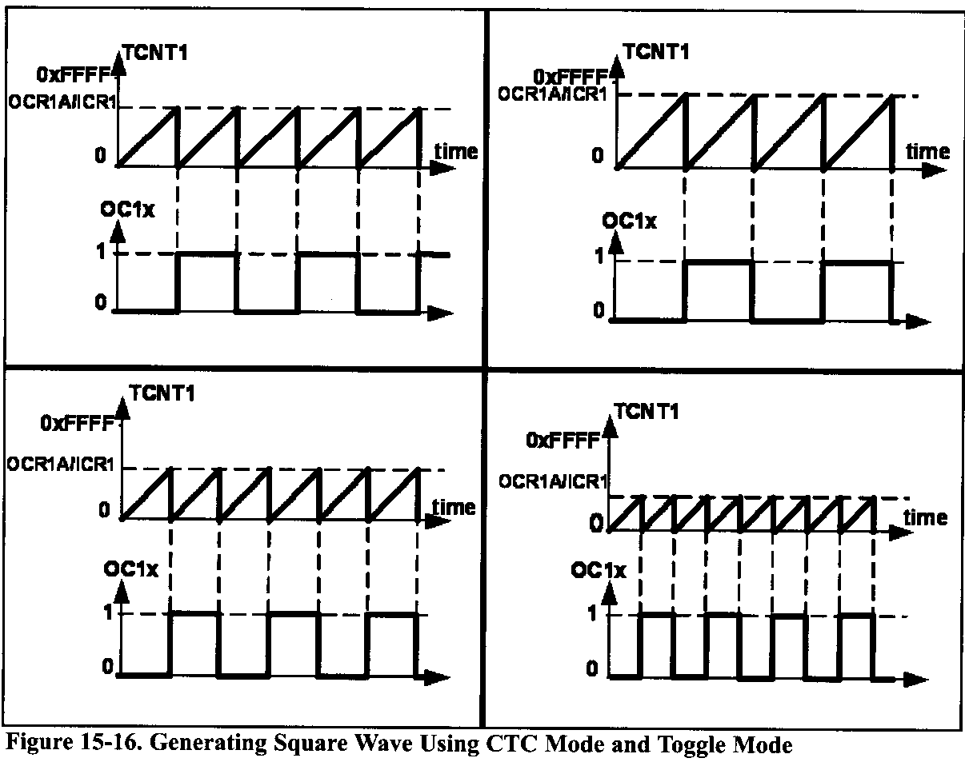
INPUT CAPTURE AND WAVE GENERATION IN AVR SECTION 15.2: WAVE GENERATION USING TIMER1

Slide 46
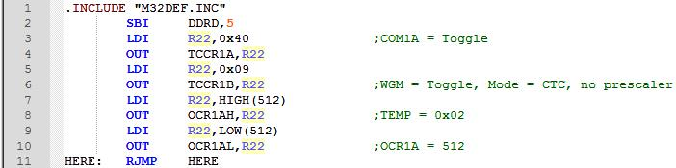
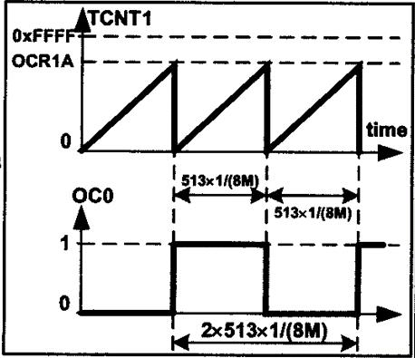
INPUT CAPTURE AND WAVE GENERATION IN AVR SECTION 15.2: WAVE GENERATION USING TIMER1
Example 15-18
Assuming XTAL = 8 MHz, calculate the frequency of the wave generated by the following program:
Solution:
From one compare match to the next one it takes
512 + 1 = 513 clocks and
T_{timer clock} = 1 / 8 MHz = 0.125 µs
T_{wave} = 2 × 513 × 0.125 µs = 128.25 µs
Fwave = 1 / 128.25 µs = 7797 Hz = 7.797 kHz

Slide 47
INPUT CAPTURE AND WAVE GENERATION IN AVR SECTION 15.2: WAVE GENERATION USING TIMER1
Example 15-19
In Example 15-18, calculate the frequency of the Wave generated in each of the fallowing cases:
OCR1A is loaded with 0x0500
XTAL =1 MHz and OCR1A is loaded With 0x5
a prescaler option of 8 is chosen, XTAL = 4 MHz, OCR = 0x150
a prescaler option of N is chosen, XTAL = Fosc, OCR1A = X
Solution:
0x500+1=0x501=1281 clocks and T_{timer clock}=0.125 µs ⇒ T_{wave}=2×1281×0.125µs=320.25 µs ⇒ F_{wave}=1/320.25µs=3122.56 Hz
5+1=6 clocks and T_{timer clock} =1/1 MHz= 1µs⇒ T_{wave}=2×6×1µs=12 µs ⇒ F_{wave}=1/12 µs= 83,333 Hz = 83.333 kHz
0x150+1=0x151=337 clocks and T_{Timer clock}=8×1/4 MHz= 2µs ⇒ T_{wave}=2×337×2µs=1348µs ⇒ F_{wave}=1/2416µs=741.8 Hz
X+1clocks and T_{Timer clock}=N×1/F_{OSC}=N/Fosc ⇒ T_{wave}=2×(X+1)×N/F_{osc} ⇒F_{wave}=1/T_{waveFose}/[2N(X+1)]

Slide 48
INPUT CAPTURE AND WAVE GENERATION IN AVR SECTION 15.2: WAVE GENERATION USING TIMER1
FOC1A (Force Output Compare) and FOC1B flags
Writing 1 to the FOC1A bit of the TCCR1A register forces the Waveform Generator A to act as if a compare match has occurred. Writing 1 to the FOC1B bit of the TCCR1B register forces Waveform Generator B to act as if a compare match has occurred.

Slide 49
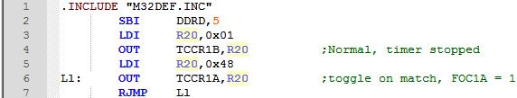
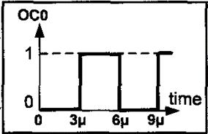
INPUT CAPTURE AND WAVE GENERATION IN AVR SECTION 15.2: WAVE GENERATION USING TIMER1
Example 15-20
Assuming XTAL = 1 MHz, draw the wave generated by the following program:
Solution:
The wave generator is in toggle mode. So, it toggles on compare match. Setting the FOC1A bit causes the wave generator to act as if the compare match has occurred. So, the OC1A pin toggles. The execution of instructions "OUT TCCR1A, R20" and "RJMP L1" takes 1 and 2 clocks, respectively. So, toggle occurs after 1 + 2 = 3 clocks

Slide 50
INPUT CAPTURE AND WAVE GENERATION IN AVR SECTION 15.3: INPUT CAPTURE PROGRAMMING
INPUT CAPTURE PROGRAMMING
The Input Capture function is widely used for many applications. Among them are
recording the arrival time of an event,
pulse width measurement, and
period measurement.
In ATmega32, Timer1 can be used as the Input Capture to detect and measure the events happening outside the chip. Upon detection of an event, the TCNT value is loaded into the ICR1 register, and the ICF1 flag is set.

Slide 51
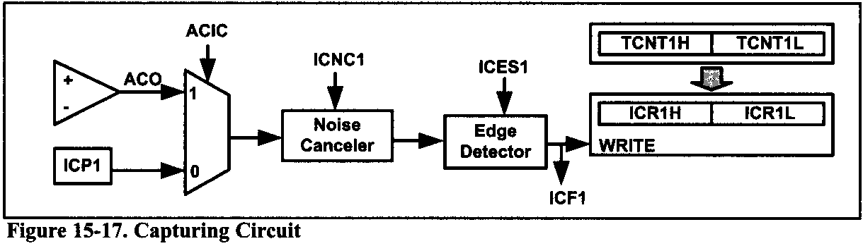
INPUT CAPTURE AND WAVE GENERATION IN AVR SECTION 15.3: INPUT CAPTURE PROGRAMMING
As shown in Figure 15-17, there are two event sources: (1) the ICP1 pin, which is PORTD.6 in ATmega32, and (2) the output of the analog comparator. We can use the ACIC flag to select the event source. ACIC is a bit of the ACSR register, as shown in Figure 15-18.

Slide 52
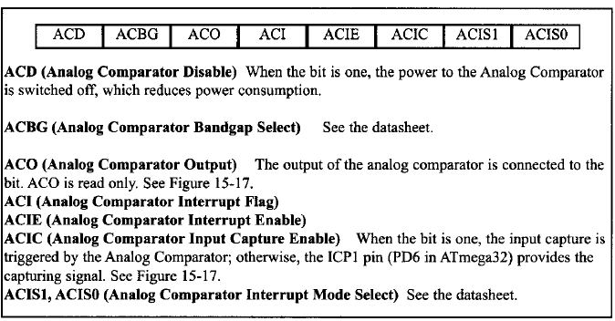
INPUT CAPTURE AND WAVE GENERATION IN AVR SECTION 15.3: INPUT CAPTURE PROGRAMMING
Fig 15-18 Analog Comparator Control and Status Register - ACSR

Slide 53

INPUT CAPTURE AND WAVE GENERATION IN AVR SECTION 15.3: INPUT CAPTURE PROGRAMMING
Fig 15-19 TCCR1B (Timer/Counter Control Register) Register ICNC1, ICES1

Slide 54

INPUT CAPTURE AND WAVE GENERATION IN AVR SECTION 15.3: INPUT CAPTURE PROGRAMMING
Example 15-21
Using Figures 15-12 and 15-19, find TCCR1A and TCCRIB, for capturing on rising edge, no noise canceller, no prescaler, and timer mode = Normal.
Solution:

Slide 55
INPUT CAPTURE AND WAVE GENERATION IN AVR SECTION 15.3: INPUT CAPTURE PROGRAMMING
Steps to program the Input Capture function
We use the following steps to measure the edge arrival time for the Input Capture function.
1. Initialize the TCCR1A and TCCR1B for a proper timer mode (any mode other than modes 8, 10, 12, and 14), enable or disable the noise canceller, and select the edge (positive or negative) we want to measure the arrival time for.
2. Initialize the ACSR to select the desired event source.
3. Monitor the ICF1 flag in TIFR to see if the edge has arrived. Upon the arrival of the edge, the TCNT1 value is loaded into the ICR1 register automatically by the AVR.
The Input Capture function is widely used to measure the period or the pulse width of an incoming signal

Slide 56

INPUT CAPTURE AND WAVE GENERATION IN AVR SECTION 15.3: INPUT CAPTURE PROGRAMMING
Example 15-22
Assuming that clock pulses are fed into pin ICP1, write a program to read the TCNT1 value on every rising edge. Place the result on PORTA and PORTB.
Solution:
Note: Upon the detection of each rising edge, the TCNT1 value is loaded into ICR1. Also notice that we clear the ICF1 flag bit.

Slide 57
INPUT CAPTURE AND WAVE GENERATION IN AVR SECTION 15.3: INPUT CAPTURE PROGRAMMING
Measuring period
We can use the following steps to measure the period of a wave.
1. Initialize the TCCR1A and TCCR1B.
2. Initialize the ACSR to select the desired event source.
3. Monitor the ICF1 flag in TIFR to see if the edge has arrived. Upon the arrival of the edge, the TCNT1 is loaded into the ICR1 register automatically by the AVR.
4. Save the ICR1.
5. Monitor the ICF1 flag in TIFR to see if the second edge has arrived. Upon the arrival of the edge, the TCNT1 is loaded into the ICR1 register automatically by the AVR.
6. Save the ICR1 for the second edge. By subtracting the second edge value from the first edge value we get the time.

Slide 58

INPUT CAPTURE AND WAVE GENERATION IN AVR SECTION 15.3: INPUT CAPTURE PROGRAMMING
Example 15-23
Assuming that clock pulses are fed into pin PORTD.6, write a program to measure the period of the pulses, Place the binary result on PORTA and PORTB.
Solution:

Slide 59


INPUT CAPTURE AND WAVE GENERATION IN AVR SECTION 15.3: INPUT CAPTURE PROGRAMMING

Slide 60

INPUT CAPTURE AND WAVE GENERATION IN AVR SECTION 15.3: INPUT CAPTURE PROGRAMMING
Using Input Capture to Measure Period

Slide 61
INPUT CAPTURE AND WAVE GENERATION IN AVR SECTION 15.3: INPUT CAPTURE PROGRAMMING
Example 15-24
The frequency of a pulse is between 50 Hz and 60 Hz. Assume that a pulse is connected to ICP1 (pin PD6). Write a program to measure its period and display it on PORTB. Use the prescaler value that gives the result in a single byte. Assume XTAL = 8 MHz.
Solution:
8MHz ×1/1024 = 7812.5 Hz due to prescaler and T = 1/7812.5 Hz = 128 µs.
The frequency of 50 Hz gives us the period of 1/50 Hz = 20 ms. So, the output is 20 ms/128 µs = 156.
The frequency of 60 Hz gives us the period of 1/60 Hz = 16.6 ms. So, the output is 16.6 ms/128 µs = 130.

Slide 62


INPUT CAPTURE AND WAVE GENERATION IN AVR SECTION 15.3: INPUT CAPTURE PROGRAMMING

Slide 63
INPUT CAPTURE AND WAVE GENERATION IN AVR SECTION 15.3: INPUT CAPTURE PROGRAMMING
Measuring pulse width
We can use the following steps to measure the pulse width of a wave.
1. Initialize TCCR1A and TCCR1B, and select capturing on rising edge.
2. Initialize ACSR to select the desired event source.
3. Monitor the ICF1 flag in TIFR to see if the edge has arrived. Upon the arrival of the edge, the TCNT1 value is loaded into the ICR1 register automatically by the AVR.
4. Save the ICR1 and change the capturing edge to the falling edge.
5. Monitor the ICF1 flag in TIFR to see if the second edge has arrived. Upon the arrival of the edge, the TCNT1 value is loaded into the ICR1 register automatically by the AVR.
6. Save the ICRl for the second edge. Subtract the second edge value from the first edge value to get the time.

Slide 64

INPUT CAPTURE AND WAVE GENERATION IN AVR SECTION 15.3: INPUT CAPTURE PROGRAMMING
Using Input Capture to Measure Period and Pulse Width

Slide 65

INPUT CAPTURE AND WAVE GENERATION IN AVR SECTION 15.3: INPUT CAPTURE PROGRAMMING
Waveform generators in Timer1
Example 15-25
Using Figure 15-19, find TCCR1 B for no noise canceller, prescaler = 1024, and timer in Normal mode: (a) for capturing on rising edge (b) for capturing on falling edge
Solution:

Slide 66
INPUT CAPTURE AND WAVE GENERATION IN AVR SECTION 15.3: INPUT CAPTURE PROGRAMMING
Example 15-26
Assume that a 60-Hz frequency pulse is connected to ICP1 (pin PD6). Write a program to measure its pulse width. Use the prescaler value that gives the result in a single byte. Display the result on PORTB. Assume XTAL = 8 MHz.
Solution:
The frequency of 60 Hz gives us the period of 1/60 Hz = 16.6 ms.
Now, 8 MHz × 1/1024 = 7812.5 Hz due to prescaler and
T = 1/7812.5 Hz = 128 µs for TCNT. That means we get the value of 130 (1000 0010 binary) for the period since 16.6 ms / 128 us = 130.
Now the pulse width can be anywhere between 1 to 129.

Slide 67


INPUT CAPTURE AND WAVE GENERATION IN AVR SECTION 15.3: INPUT CAPTURE PROGRAMMING

Slide 68
INPUT CAPTURE AND WAVE GENERATION IN AVR SECTION 15.3: INPUT CAPTURE PROGRAMMING
Example 15-27
Assume that a temperature sensor is connected to pin PD6. The temperature provided by the sensor is proportional to pulse width and is in the range of 1µS to 250µs. Write a program to measure the temperature if 1 µs is equal to 1 degree. Use the prescaler value that gives the result in a single byte. Display the result on PORTB. Assume XTAL = 8 MHz.
Solution:
8 MHz ×1/8 = 1 MHz = 1,000,000 Hz due to prescaler and T = 1/1,000,000 Hz = 1 µs for TCNT. That means we get the values between 1 and 65,536 µs for the TCNT, but since the pulse width never goes beyond 250 µs we should be able to display the temperature value on PORTB.

Slide 69


INPUT CAPTURE AND WAVE GENERATION IN AVR SECTION 15.3: INPUT CAPTURE PROGRAMMING

Slide 70
INPUT CAPTURE AND WAVE GENERATION IN AVR SECTION 15.3: INPUT CAPTURE PROGRAMMING
Analog comparator
As shown in Figure 15-17, when the ACIC bit is set, the analog comparator provides the trigger signal for the input capture unit. The analog comparator is an op-amp that compares the voltage of AIN1 (PORTB.3 in ATmega32) with AIN0 (PORTB.2 in ATmega32).
If the voltage of AIN1 is higher than AIN0, the comparator's output is 1; otherwise, its output is 0. For more information, see the datasheet of the ATmega32.

Slide 71

INPUT CAPTURE AND WAVE GENERATION IN AVR SECTION 15.4: C PROGRAMMING
Example 15-28 (C version of Example 15-2)
Write a program that (a) after 4 external clocks turns on an LED connected to the OC0 pin, and (b) toggles the OC0 pin every 4 pulses.
Solution:
(a)

Slide 72

INPUT CAPTURE AND WAVE GENERATION IN AVR SECTION 15.4: C PROGRAMMING
(b)

Slide 73

INPUT CAPTURE AND WAVE GENERATION IN AVR SECTION 15.4: C PROGRAMMING
Example 15-29 (C version of Example 15-4)
Rewrite the program of Example 15-4 using C.
Solution:

Slide 74

INPUT CAPTURE AND WAVE GENERATION IN AVR SECTION 15.4: C PROGRAMMING
Example 15-30 , (C, version of Example 15-6)
Rewrite the Program of Example 15,6 using C.
Solution:

Slide 75

INPUT CAPTURE AND WAVE GENERATION IN AVR SECTION 15.4: C PROGRAMMING
Example 15-31 (C,version of. Example 15-8)
Rewrite the program of Example 15-8 using C.
Solution:

Slide 76

INPUT CAPTURE AND WAVE GENERATION IN AVR SECTION 15.4: C PROGRAMMING
Example 15-32 (C version of Example 15-9)
Rewrite the program of Example 15-9 using C.
Solution:

Slide 77

INPUT CAPTURE AND WAVE GENERATION IN AVR SECTION 15.4: C PROGRAMMING
Example 15-33 (C version of Example 15-10)
Rewrite the program of Example 15-10 using C.
Solution:

Slide 78

INPUT CAPTURE AND WAVE GENERATION IN AVR SECTION 15.4: C PROGRAMMING
Example 15-34 (C version of Example 15-12)
Rewrite the program of Example 15-12 using C.
Solution:

Slide 79

INPUT CAPTURE AND WAVE GENERATION IN AVR SECTION 15.4: C PROGRAMMING
Example 15-35 (C version of Example 15-13)
Rewrite the program of Example 15-13 using C.
Solution:

Slide 80

INPUT CAPTURE AND WAVE GENERATION IN AVR SECTION 15.4: C PROGRAMMING
Example 15-36 (C version of Example 15-18)
Rewrite the program of Example 15-18 using C.
Solution:

Slide 81

INPUT CAPTURE AND WAVE GENERATION IN AVR SECTION 15.4: C PROGRAMMING
Example 15-37 (C version of Example 15-20)
Rewrite the program of Example 15-20 using C.
Solution:

Slide 82

INPUT CAPTURE AND WAVE GENERATION IN AVR SECTION 15.4: C PROGRAMMING
Example 15-38 (C version of Example 15-22)
Assuming that clock pulses are fed into pin ICP1, write a program to read the TCNT1 value on every rising edge. Place the result on PORTA and PORTB.
Solution:

Slide 83

INPUT CAPTURE AND WAVE GENERATION IN AVR SECTION 15.4: C PROGRAMMING
Example 15-39 (C version of Example 15-23)
Assuming that clock pulses are fed into pin PORTD.6, write a program to measure the period of the pulses. Place the binary result on PORTA and PORTB.
Solution:

Slide 84

INPUT CAPTURE AND WAVE GENERATION IN AVR SECTION 15.4: C PROGRAMMING
Example 15-40 (C version of Example 15-24)
The frequency of a pulse is either 50 Hz or 60 Hz. Assume that a the pulse is connected to ICP1 (pin PD6). Write a program to measure its period and display it on PORTB. Use the prescaler value that gives the result in a single byte. Assume XTAL = 8 MHz.
Solution:

Slide 85

INPUT CAPTURE AND WAVE GENERATION IN AVR SECTION 15.4: C PROGRAMMING
Example 15-41 (C version of Example 15-26)
Assume that a 60-Hz frequency pulse is connected to ICP1 (pin PD6). Write a program to measure its pulse width. Use the prescaler value that gives the result in a single byte. Display the result on PORTB. Assume XTAL = 8 MHz.
Solution:

Slide 86

INPUT CAPTURE AND WAVE GENERATION IN AVR SECTION 15.4: C PROGRAMMING
Example 15-42 (C version of Example 15-27)
Assume that a temperature sensor is connected to pin PD6. The temperature provided by the sensor is proportional to pulse width and is in the range of 1µs to 250 µs. Write a program to measure the temperature if 1 µs is equal to 1 degree. Use the prescaler value that gives the result on PORTS. Assume XTAL = 8 MHz.
Solution:

